Slide 1

Digital Comics as Literacy Learning in Elementary Schools
Deden Much. Darmadi,
S. Nailul Muna Aljamaliah
Universitas Nurtanio Bandung,
Universitas Pendidikan Indonesia

Slide 2

INTRODUCTION
To increase students' interest in reading, it is necessary to design reading activities that are fun and interesting for students, one of which is with comics. Comic content is entertaining, making comics a reading material that is not only favored by children, but also by adults. Comics are media with images that present a message or information through a story and are presented in the form of a series of images, so that they can motivate students to read, learn and be helped in understanding the material.
Comics have advantages according to Waluyanto (in Devi 2019, p. 609), namely being able to provide entertainment with simple comic storytelling and presented in a humorous style, it will be easy to grasp a problem because basically comics are a unique visual communication medium that combines text and images in a creative form and has the power to convey information in a popular and easy to understand manner.

Slide 3
INTRODUCTION
With the times, digital comics are the right choice to make it easier for students to learn because they can be accessed anywhere and this is of course very important for educators to be creative in innovating digital-based learning, so that students are not bored, and can achieve learning objectives well.

Slide 4

METHOD
The research method used is descriptive qualitative. Data collection techniques are observation and interviews with teachers and students.

Slide 5

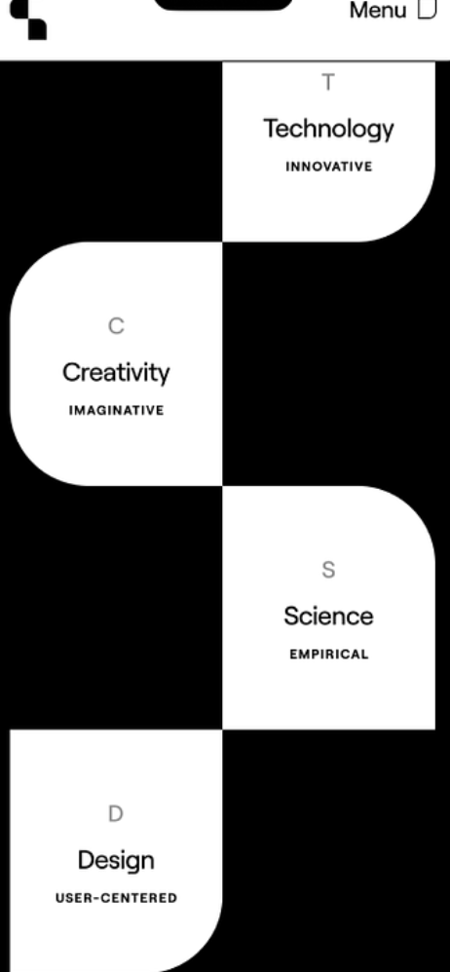

RESULT AND DISCUSSION
Digital Comics
Prior to the implementation of the literacy learning process in elementary schools, researchers have developed digital comics as a medium that can be used in the learning process. The comics developed contain a story that is tailored to the abilities of elementary school children. In this case, the story used is the story of the Budak Pahatu.

Slide 6

RESULT AND DISCUSSION
Literacy Learning in Elementary Schools
Data were collected through observations and interviews conducted at several elementary schools in Bandung City. The results showed that there was a very significant effect on students literacy skills, especially after using digital comics media. This is because students can access more digital comics independently from their respective devices. In addition, digital comics can also be used as a medium in delivering material that is easy to understand.

Slide 7
CONCLUSION
Literacy learning in elementary schools using digital comics is of great interest to students. Digital comics is very interesting to be applied in elementary schools. The use of digital comics helps teachers in increasing students interest in literacy skills, students are also very enthusiastic because learning is done with a combination of technological developments used as learning media. However, there are still obstacles faced by students when learning using digital comics, when there is too much screen time for students, it will cause visual disturbances. This of course must be limited in its use.

Slide 8
Thank You

